Slide 1
DATA MINING LECTURE 6
Linear Regression
Logistic Regression
Neutral Networks
A Little Bit of Deep Learning
CSC177
Dr. Victor Chen

Slide 2
Regression Problem
The problem of predicting continuous values is called regression problem
General approach: find a continuous function that models the continuous points.

Slide 3
Linear Regression with one input
A simple regression has the coefficient β and the constant α. The equation is then:
y = α + β * x
where α is y-intercept and β is slope

Slide 4
Linear Regression with more than one input
Multiple Linear Regression
A multiple regression is in the following form:
y = α + β₁ * X₁ + β₂ * X₂ + … + β_{k} * X_{k}
where k is the number of variables, or parameters.

Slide 5
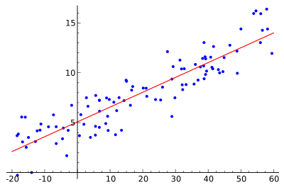
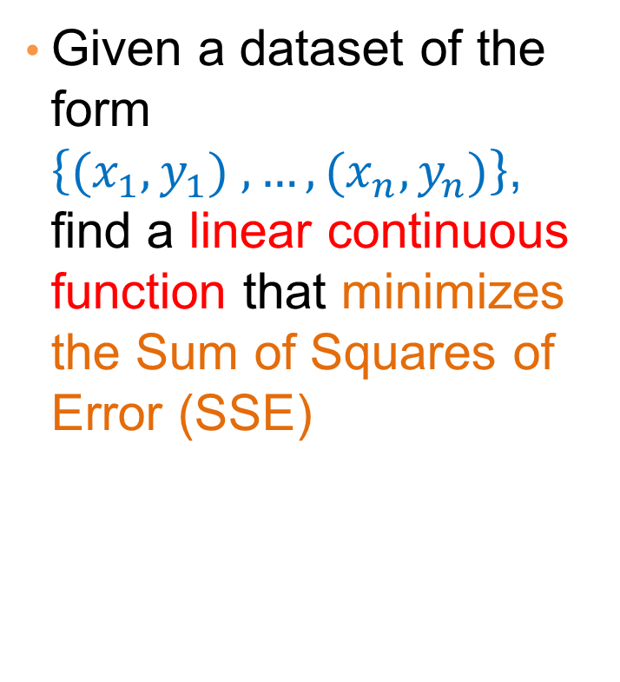
Linear regression for 2D data
Given a dataset of the form $\left\{{(x}_{1},y_{1}) ,…,{(x}_{n},y_{n})\right\}$, find a linear continuous function that minimizes the Sum of Squares of Error (SSE)

Slide 6
Linear Regression
y’ = b0 + b1X
є
Dependent variable (y)
b1 = slope
= ∆y/ ∆x
b0 (y intercept)
Independent variable (x)

Slide 7
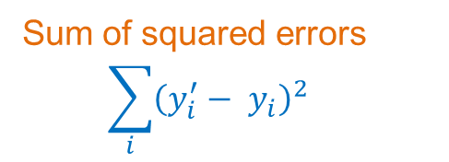
Sum of Squares of Error (SSE)
Regression
Sum of squared errors
$$\sum_{i}{{\left(y_{i}^{′}− y_{i}\right)}^{2}}$$
Dependent variable
Independent variable (x)
Sum of Squares of Error (SSE) is the sum of all the squared errors.

Slide 8
Sum of Squares of Regression (SSR)
Data mean
Dependent variable
Independent variable (x)
Sum of Squares of Regression (SSR) is the sum of the squared differences between each prediction and the mean of data.

Slide 9
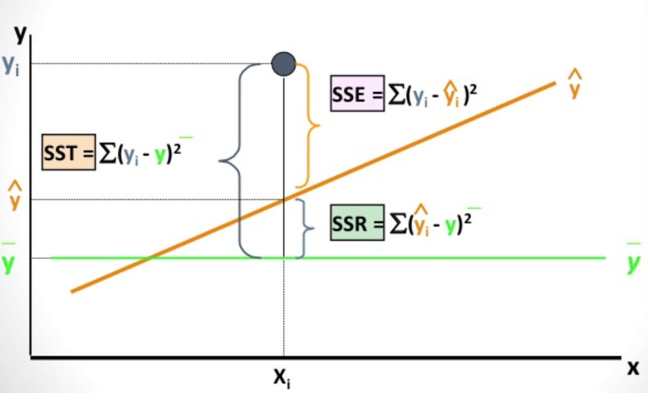
Sum of Squares of Total (SST)
SST = SSE + SSR

Slide 10
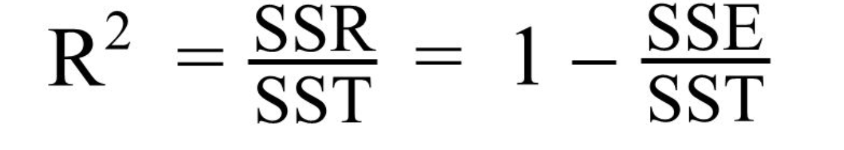
R-Squared score
The Coefficient of Determination
R-Squared score can be used as a single summary number to measure the quality of linear regression model
The value of R² can range between 0 and 1.
The higher R^{2,} the more accurate the regression model is.

Slide 11
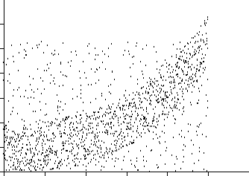
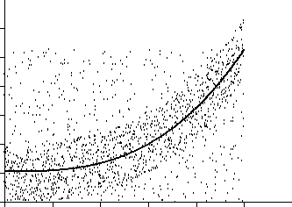
Nonlinear functions can also be fit as regressions
Nonlinear Regression
Any nonlinear continuous functions can also be fit as regressions, including power, Logarithmic, Exponential, and Logistic.

Slide 12
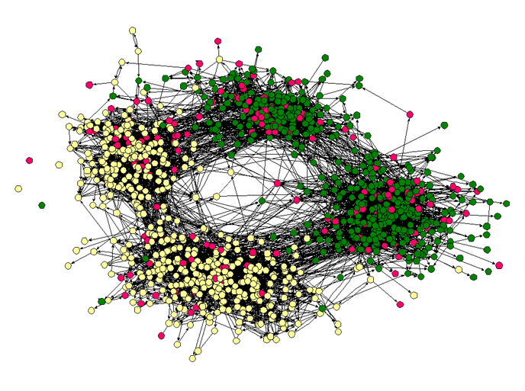
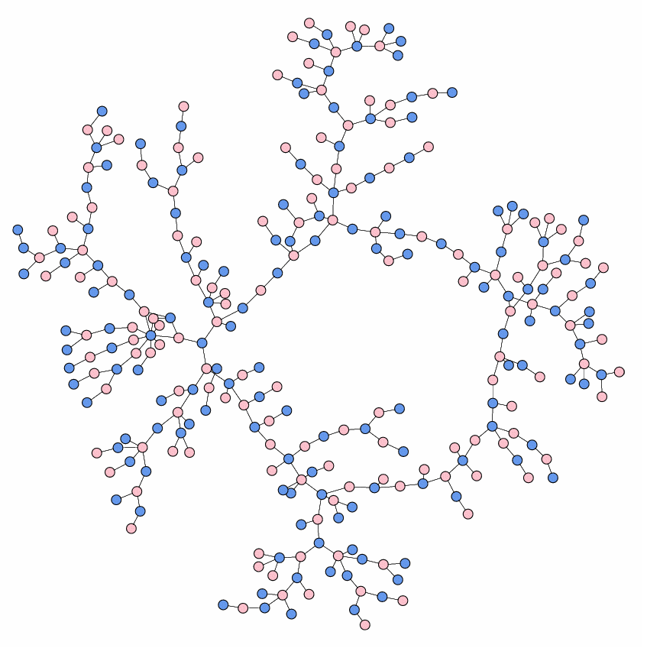
A Real Example: Social Network Analysis
High school dating
High school friendship

Slide 13



A Real Example: Social Network Analysis
In link prediction, given any two arbitrary users, we aim to answer:
What is the likelihood that a particular link (relationship) exists between them?
Notes:
A fundamental problem in social network analysis.

Slide 14
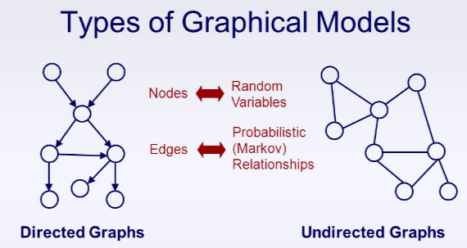
Markov Networks v.s. Bayesian Networks
Haiquan Chen, Wei-Shinn Ku, Haixun Wang, Liang Tang, Min-Te Sun: Scaling Up Markov Logic Probabilistic Inference for Social Graphs. IEEE Trans. Knowl. Data Eng. 29(2): 433-445 (2017)

Slide 15
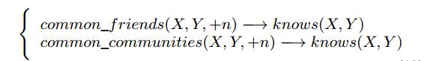
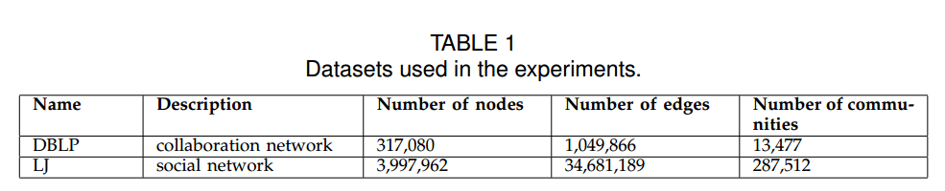
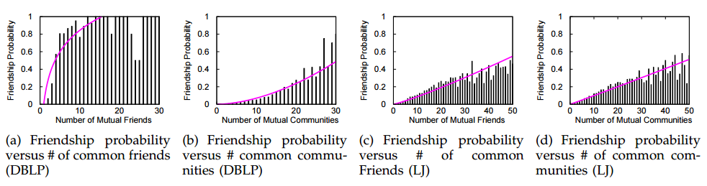
Experimental validation
Notes:
The weight wj for formula fj can be approximated as wj = log pj /1−pj , where pj is the probability that formula fj holds.

Slide 16
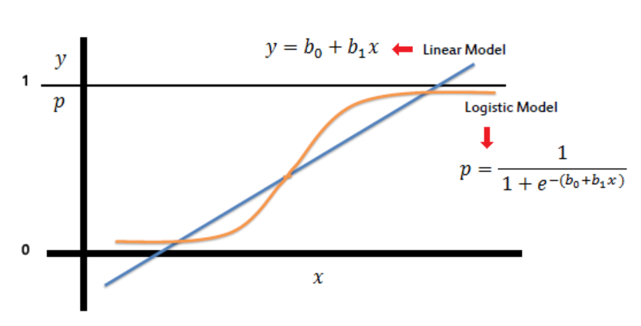

Now Logistic Regression…

Slide 17
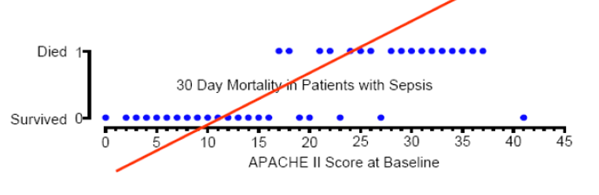
Linear Regression Doesn’t Work
A linear function/regression is not good
It may produce probabilities beyond [0, 1]
Note: APACHE II is one of several ICU scoring systems.

Slide 18
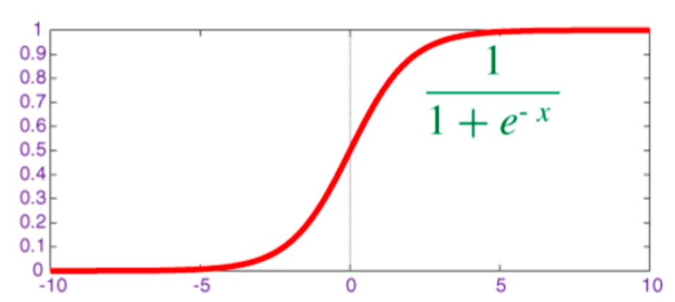
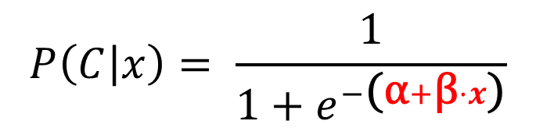
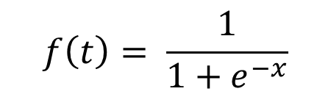
Logistic Regression
Logistic (Sigmoid) function maps any input x between [0, 1]
$$f\left(t\right)= \frac{1}{1+e^{−x}}$$
Logistic regression is a linear
regression on the Sigmoid function
$$P\left(C | x\right)= \frac{1}{1+e^{−\text{(}\text{α}+\text{β}⋅x\text{)}}}$$
Q: What is the logistic regression model for more than one dimension?

Slide 19
Logistic Regression
For 2-class problem, the probability threshold is set to 0.5 so
If the predicted probability >= 0.5, predict “y = 1”,
If the predicted probability > 0.5, predict “y = 0”,

Slide 20
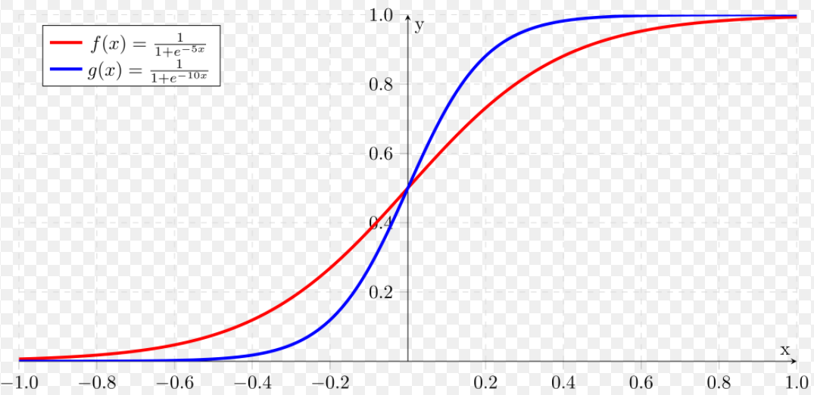

How $\text{β}$ affects the model

Slide 21
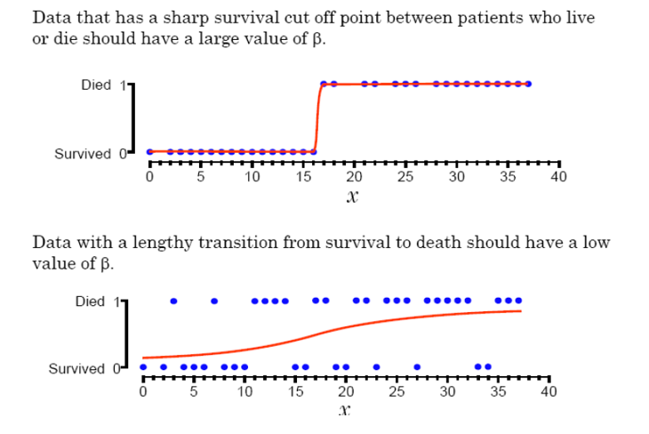
Compare Two Models In One Dimension
Q: What x value makes the model output a probability of 0.5?

Slide 22
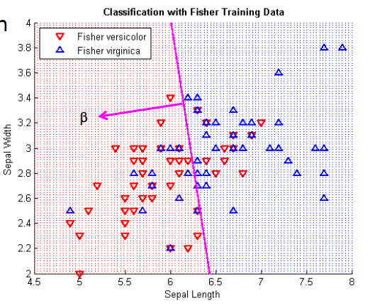
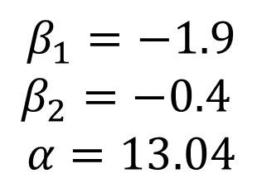
Logistic regression in 2D space
Predict Iris flower species based on sepal length and sepal width only
Coefficients
$$β_{1}=−1.9$$
$$β_{2}=−0.4$$
$$α=13.04$$

Slide 23
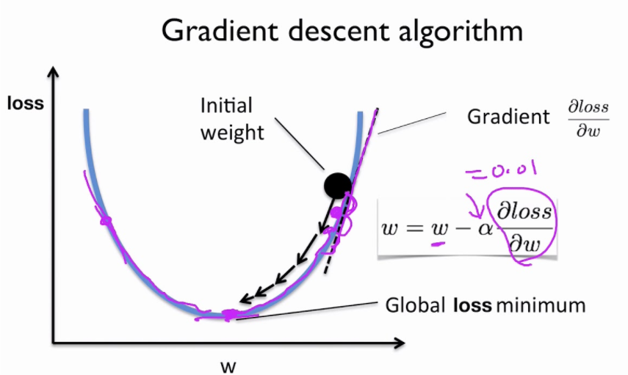
Estimating the coefficients
Use gradient descent algorithm to find the near-optimal coefficients for linear/logistic regression

Slide 24
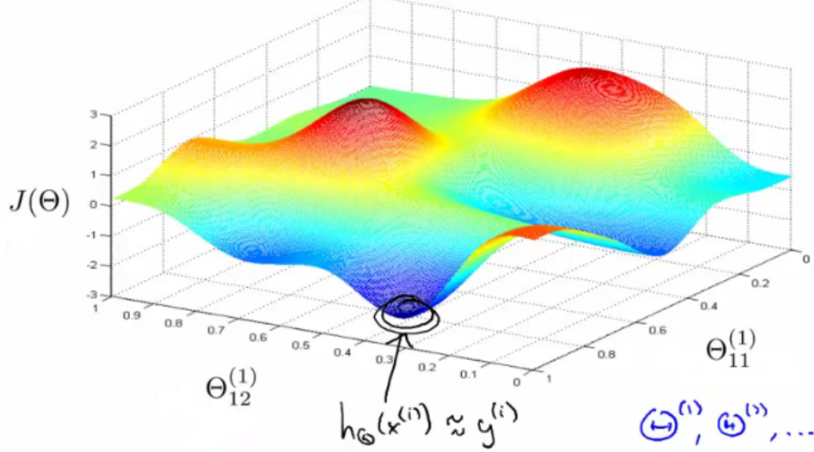
Gradient descent for two parameters

Slide 25
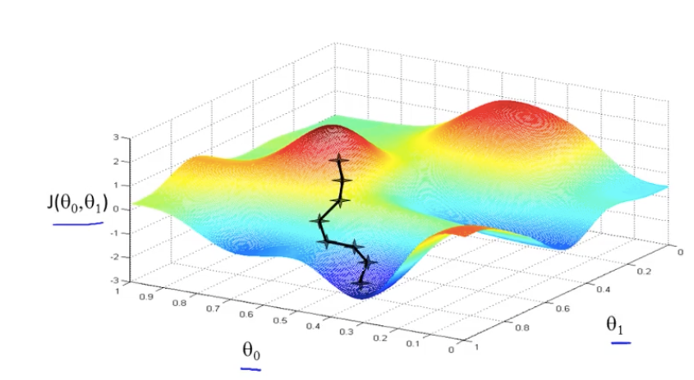
Gradient descent for two parameters

Slide 26
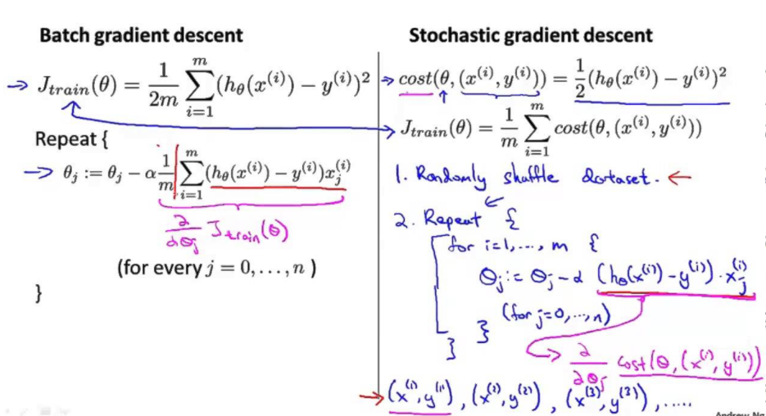
Gradient descent implementation

Slide 27
Sklearn implementation
http://scikit-learn.org/stable/modules/generated/sklearn.linear_model.LinearRegression.html
http://scikit-learn.org/stable/modules/generated/sklearn.linear_model.LogisticRegression.html

Slide 28
Logistic/Linear Regression Advantages
Linear regression produces a continuous output.
Logistic regression produces class membership with predicted probability .
The coefficients can be used for understanding the feature importance.
Works for relatively large datasets

Slide 29
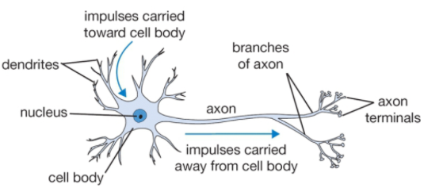

Neutral networks
Logistic regression can be considered as the simplest form of a neutral network, which is a collection of perceptron.
Perceptron is seen as an analogy to a biological neuron.

Slide 30
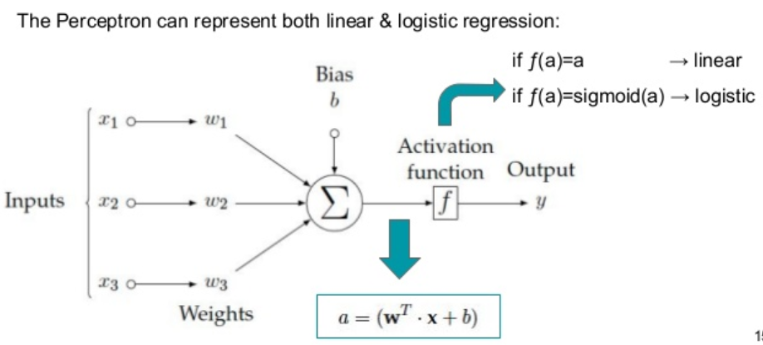
Perceptron (Neuron)

Slide 31
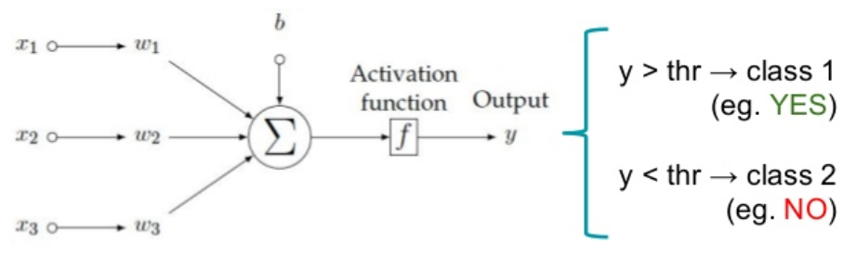
2-class classification with one neuron

Slide 32
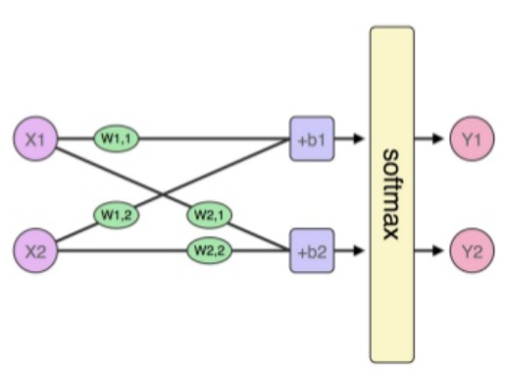
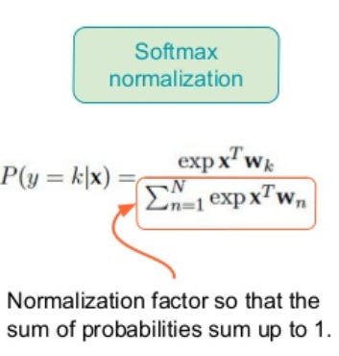
2-class classification with two neurons, one for each class
Putting multiple neurons in parallel we can predict multiple classes

Slide 33
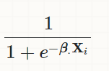
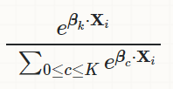
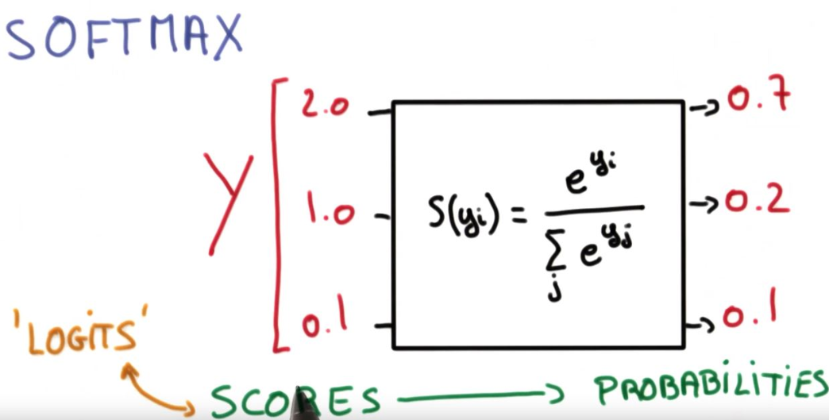
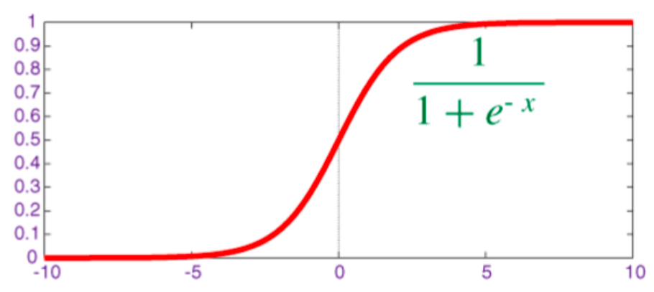
sigmoid vs softmax
sigmoid function is used for the two-class logistic regression
softmax function is used for the multiclass logistic regression

Slide 34
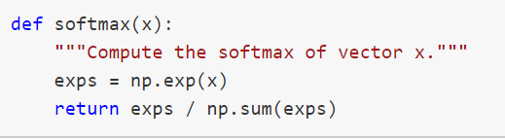
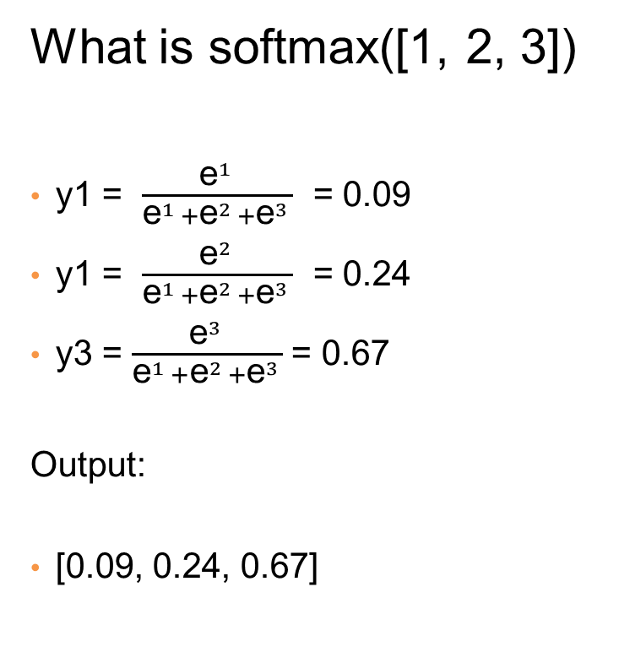
Softmax implementation
What is softmax([1, 2, 3])
y1 = $\frac{{\text{e}}^{1 }}{{\text{e}}^{1 }+{\text{e}}^{2 }+{\text{e}}^{3 }}$ = 0.09
y1 = $\frac{{\text{e}}^{2 }}{{\text{e}}^{1 }+{\text{e}}^{2 }+{\text{e}}^{3 }}$ = 0.24
y3 = $\frac{{\text{e}}^{3 }}{{\text{e}}^{1 }+{\text{e}}^{2 }+{\text{e}}^{3 }}$= 0.67
Output:
[0.09, 0.24, 0.67]

Slide 35
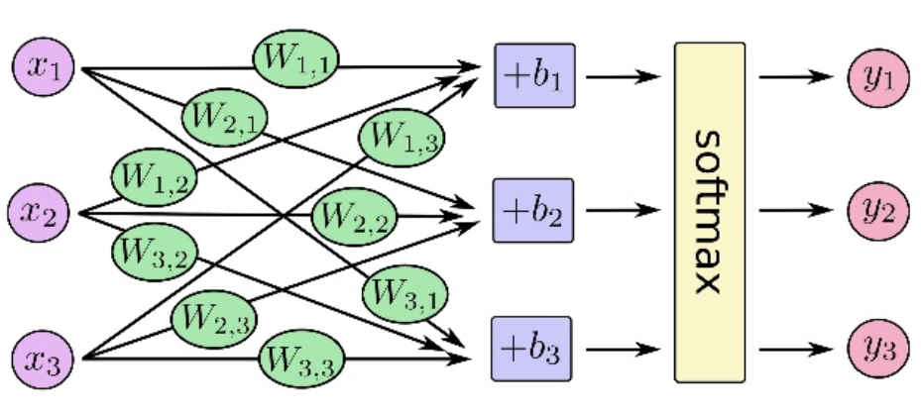
3-class classification with three neurons
Putting multiple neurons in parallel we can predict multiple classes

Slide 36
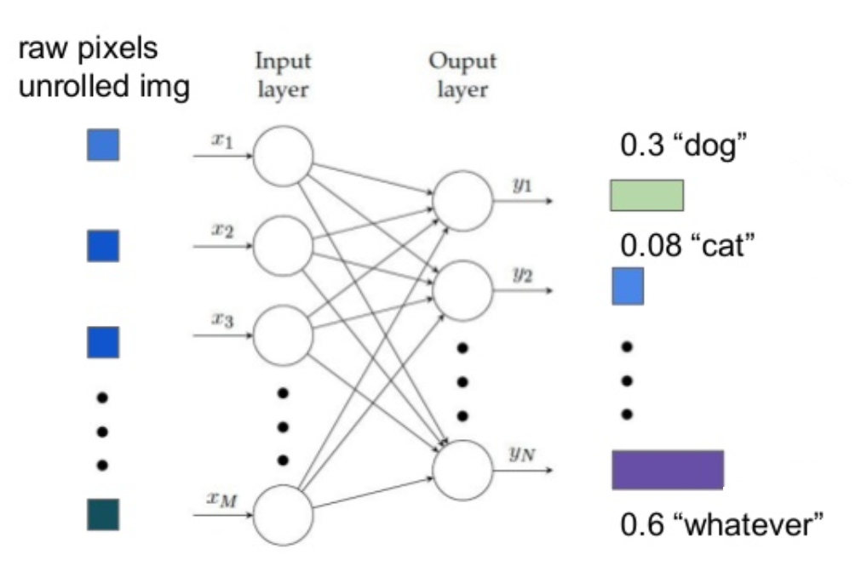

Neutral Network = Multi Layer Perceptron
Multiple classes can be predicted by putting many neurons in parallel.

Slide 37
Sklearn implementation
http://scikit-learn.org/stable/modules/neural_networks_supervised.html#

Slide 38
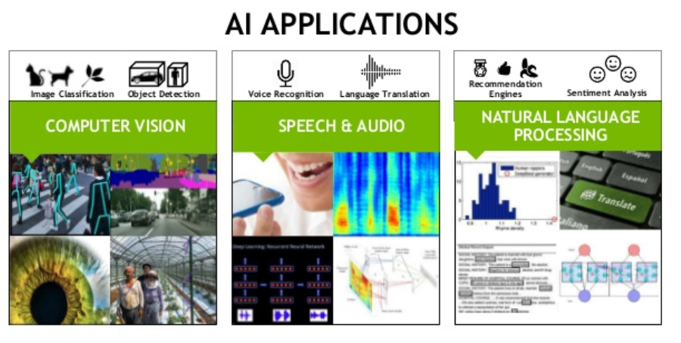
Deep learning

Slide 39
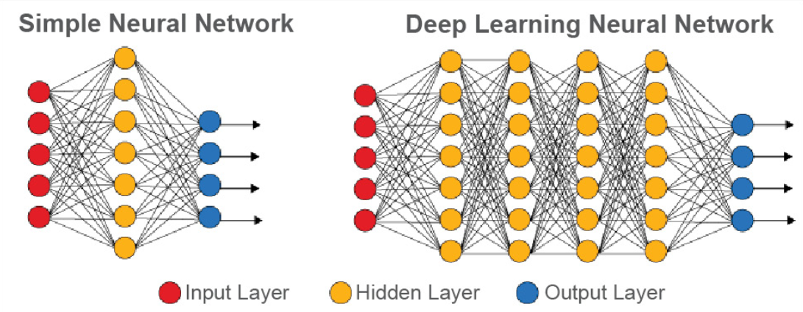
Neural networks vs deep learning neural networks
"Normal" neural networks usually have one to two hidden layers and are used for SUPERVISED classification.
Deep learning neural network have more hidden layers and can be used for both UNSUPERVISED and SUPERVISED learning tasks.

Slide 40
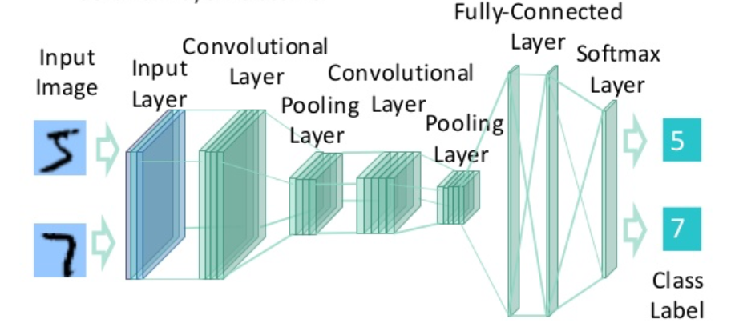
An example deep learning neural network

Slide 41

